Slide 1

BSW Public Health
Module 1: Introduction to Public Health

Slide 2
Module Objectives
Understand what public health is and what it means in BSW
Understand the key pillars of public health
Describe the workforce that makes up public health
Understand how to find key public health information
Consider how public health might be relevant to your job role

Slide 3
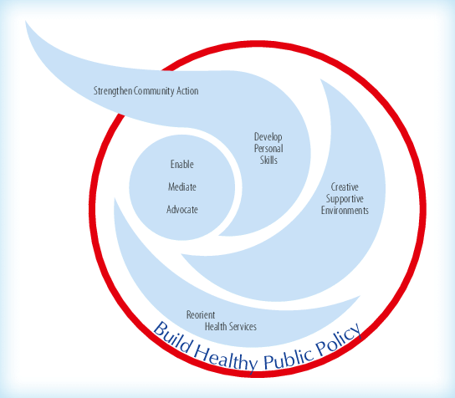
What is Public Health?
Public health is ‘the science and art of preventing disease, prolonging life and promoting health’ (Acheson, 1988)
Public health works at a population-level rather than an individual-level
Public health does not aim to treat disease, but instead focusses on preventing disease and improving health and well-being
The Ottawa Charter for Health
Notes:
Public health is the science and art of promoting and protecting health and wellbeing, preventing ill health and prolonging life through the organised efforts of society. Public health works to improve health and well-being at a population level rather than an individual level and the aim is to prevent illness and disease. This can be primary prevention which involves preventing a problem or disease occurring in the first place such as vaccination programs, secondary prevention which involves recognising disease early and promptly intervening once a problem starts to emerge for example by blood pressure screening programs, or tertiary prevention to make sure an ongoing problem is well managed and harmful consequences are minimised, such as education programs for managing diabetes.
The Ottawa Charter for Health was drawn up following a conference in 1986 and reflected the individual and collective commitment to the common goal of Health for all by the year 2000. More information about this charter can be found at the link.
Link: Ottawa charter for health promotion (who.int)

Slide 4
Key Functions of Public Health
Health Protection
Health Improvement
Health Intelligence
Healthcare Public Health
Notes:
The main functions of public health can be broadly split into health protection, health improvement, health intelligence and healthcare public health.
Health protection involves protecting the population from ill-heath. This could be in the form of promoting vaccination against infectious disease, protecting the population from environmental health hazards or providing an emergency response.
Health improvement aims to promote healthy lifestyles. Work in this area might focus on smoking cessation or increasing physical activity levels. Health improvement also encompasses education, housing and employment.
Health intelligence involves measuring, monitoring and reporting population health and wellbeing. This is important for decision-making, planning and evaluation of services. It will be covered in more detail in a later slide.
Healthcare public health works to improve population health by preventing disease and improving health-related outcomes by managing access and utilisation of healthcare interventions.

Slide 5
Areas of Public Health
Public Health
Weight Management
Physical Activity
Notifiable Diseases
Domestic Violence
Warm and Safe
Alcohol and Drug Misuse
Emergency Responses
Mental Health
Five to Thrive
Smoking Cessation
Public health is vast and covers anything that could be a potential threat to population health and well-being.
Notes:
Public health covers everything that could be a potential threat to population health and well-being. The work involved is therefore vast, ranging from interventions to improve physical activity and exercise, to managing disease outbreaks like the current Covid-19 pandemic, and responding to emergency situations such as the Salisbury poisonings. Interventions can be statutory or non-statutory. Statuatory services include public health nursing, NHS health checks and substance misuse services whereas non-statutory services include work on smoking cessation and weight management.
Link to video: What is population health? | The King's Fund (kingsfund.org.uk)

Slide 6
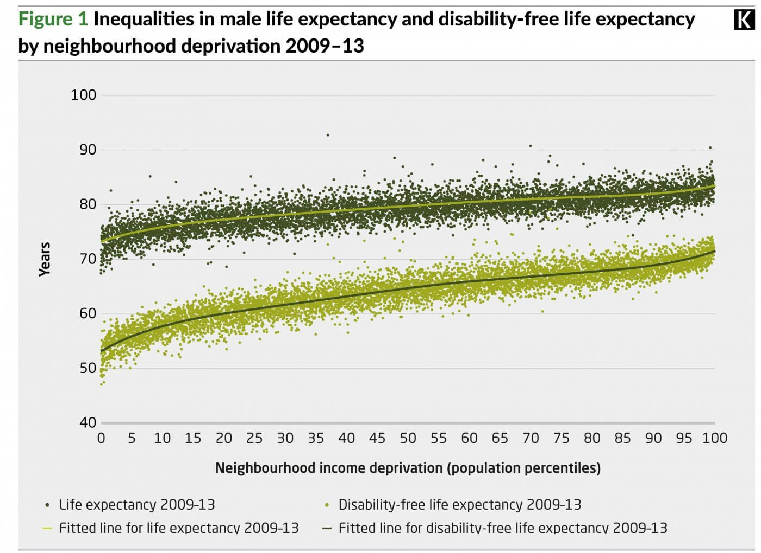
Health Inequalities
Avoidable, unfair and systematic differences in health between different groups of people
Socio-economic
Geographic
Ethnicity
Sexuality
Socially-excluded groups
Marmot Curve, King’s Fund
Notes:
Health inequalities are differences between groups of individuals that result in poorer health. Inequalities are measured by looking at the differences in health outcomes between different groups of people, i.e. life expectancy. Inequalities in health are often described across categories including:
socio-economic factors, for example, income
geography, for example, region or whether urban or rural
specific characteristics including those protected in law, such as sex, ethnicity or disability
socially excluded groups, for example, people experiencing
homelessness.
In England there is a relationship between deprivation and life expectancy known as the social gradient in health which is represented by the Marmot curve as pictured on the right. Males living in the least deprived areas live 9.4 years longer than males in the most deprived areas. A similar trend is true for females with a gap of 7.4 years.
Identifying health inequalities such as this is important when planning services and interventions and understanding the specific population groups that may need targeting. If you wish to learn more about health inequalities visit the King’s Fund website via the link.
What are health inequalities? | The King's Fund (kingsfund.org.uk)

Slide 7
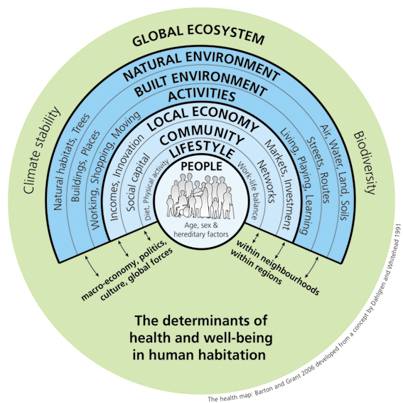
Determinants of Health
These are factors that influence the health and wellbeing of an individual or population
Barton H, Grant M. A health map for the local human habitat. Journal of the Royal Society for the Promotion of Health. 2006 Nov 1;126(6):252-.
Notes:
Wider determinants of health, also known as social determinants, are non-medical factors that influence health outcomes. They are the conditions in which people are born, grow and live. Factors such as educational attainment and access to outdoor space will also impact upon an individuals, and a communities, quality of life. As such these determinants are important considerations for public health.
It is difficult to determine exactly how important each of these factors are in terms of impact on health but several studies have estimated the impact on population health. A paper published in 2012, by the Canadian Institute of Advanced Research, found that socio-economic factors accounted for 50% of health outcomes compared to healthcare which only accounted for 25%. And it isn’t just this paper which supports the finding that wider determinants of health have such a big impact, a publication by McGinnis reported in 2002 that health care only accounted for around 15% of health outcomes whereas social circumstances and environmental exposure accounted for 45%. This demonstrates the importance of public health and addressing wider determinants of health. Even with the best healthcare system in the world, if healthcare only accounts for around 25% of health outcomes at a population level we will never achieve the goals as outlines by the public health outcomes framework.
Include link to video: What makes us healthy? - YouTube

Slide 8
Public Health Intelligence
Involves collecting individual records, grouping it into population data and analysing it to produce intelligence
Intelligence is important for:
  Decision-making
  Surveillance
  Forecasting
  Targets
  Evaluation
data
information
insight
intelligence
Notes:
In order for teams to produce effective work, robust public health intelligence is needed. Public health intelligence involves measuring, monitoring and reporting population health and wellbeing, health needs, risks and inequalities as well as use of services. Producing this population health intelligence is important for the public, clinicians, policy-makers and analysts.
Firstly raw data is collected, often just facts or figures. Context is then provided so that this becomes information, i.e. a statistic. Intelligence involves adding some meaning to the information. For example, comparisons might be made between different population groups or geographical areas. Finally, developing an understanding of what the information means and what needs to be done about it is known as insight.
Gathering intelligence is important for many reasons. To name a few:
Decision making – intelligence will inform decision making processes and planning implementation
Surveillance – intelligence is required to allow for continuous interpretation of health data as this will enable planning and appropriate service provision, i.e. monitoring disease outbreaks and planning responses accordingly.
Forecasting – intelligence is important in making predictions about what might happen over time so appropriate interventions can be put in place
Targets – intelligence is needed both for setting and maintaining targets
Evaluation – intelligence is needed to evaluate interventions and monitor their impact as well as appraising evidence through research and engagement with relevant bodies

Slide 9
Population Health Management
  Purpose:
    To help frontline teams understand current health and care needs and predict what might be needed in the future
  Aims:
    Improve physical and mental health outcomes
    Promote wellbeing
    Reduce health inequalities
20%
Notes:
Population health management is slightly different to population, or public, health intelligence. Population health management works with frontline teams to enable greater understanding of health and care needs so that predictions can be made about what local people will need in the future. Population health management has a greater focus on the wide determinants of health as only 20% of a persons health outcomes are attributed to the ability to access good quality health care which demonstrates the importance of addressing these wider determinants and the role that local health and social care can play in improving health outcomes. This is particularly important in integrated care systems which are partnerships between the organisations that deliver health and social care across a geographical area.

Slide 10
Public Health Outcomes Framework
Improve and protect the nation’s health, and improve the health of the poorest fastest
Increase healthy life expectancy
Reduce differences in life expectancy and healthy life expectancy between communities
Notes:
All the public health teams will be working towards achieving the public health priorities as outlined by the outcomes framework. The public health outcomes framework sets out a vision for public health which is to improve and protect the nation’s health and improve the health of the poorest first. There are two high level outcomes that need to be achieved to reach these goals: increase healthy life expectancy and reduce the differences in life expectancy and healthy life expectancy between communities.

Slide 11
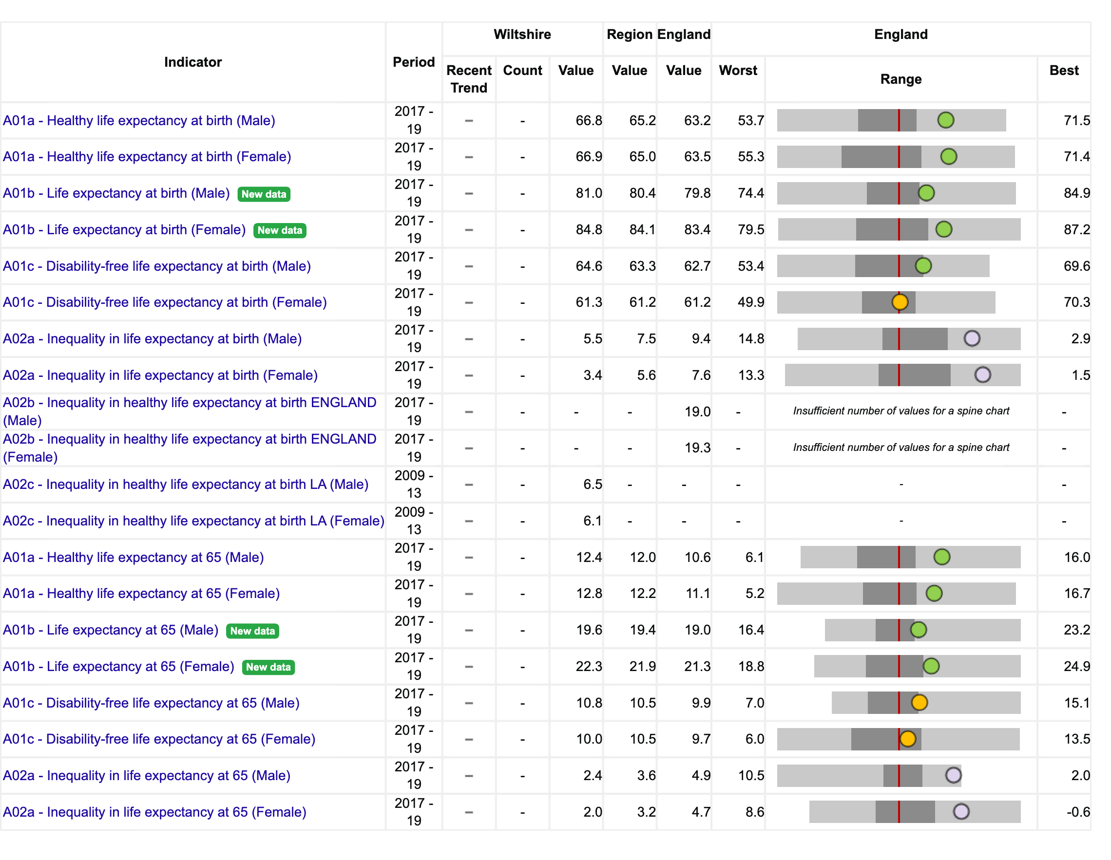
Fingertips
Notes:
Fingertips is a way of accessing public health information. Fingertips is a service that allows a wide range of indicators in a certain geographical area to be viewed.
Fingertips can be a useful resource to access to gain an insight into the area that you are working in and some of the health inequalities that might be affecting the population. For example, the public health outcomes framework data can be viewed for Wiltshire, as shown. The chart shows which indicators in the local authority are worse or better than the national average, but that being said, just because an indicator is green at a local authority level does not mean there aren’t inequalities and issues still to be resolved.
Link: www.fingertips.phe.org.uk

Slide 12
Public Sector Organisations Involved in PH
Local Authorities
UKHSA: The UK Health Security Agency
OHID: The Office for Health Improvement and Disparities
NHS EI: NHS England and NHS Improvement
Notes:
Local authorities act at a local level and will be involved in providing services for and managing the health of the local population.
The UK health security agency replaced Public Health England in 2021. It is responsible for protecting every member of every community from the impact of infectious disease, chemical, biological, radiological and nuclear incidents and other threats. The UKHSA provides intellectual, scientific and operational leadership at both a national and local level to ensure the nation’s health is secure.
OHID is the office for health improvement and disparities. It is part of the Department for Health and Social care and aims to improve the nation’s health so that everyone can expect to live more of life in good health. It also works to level up on health disparities to break the link between background and healthy life prospects.
NHS England and NHS Improvement are working together to improve care for patients and provide leadership and support to the wider NHS.

