Slide 1
BSW Academy Foundation Quality Improvement
Sarah White
Improvement Lead
August 2023

Slide 2
What is covered in this session
What is Quality Improvement?
Some Tools and Techniques
How to use A3 Thinking method
Notes:
This session will look at what we mean by Quality Improvement, some of the common tools and techniques and also how to use A3 Thinking to help plan and deliver your QI project

Slide 3
Project Management
Some QI Approaches
IHI Model for Improvement
Lean
Quality, Service Improvement and Redesign (QSIR)
Improving Together
Notes:
There are a lot of approaches available in BSW and you may have heard of some of these

Slide 4
Some QI Approaches
IHI Model for Improvement
Quality, Service Improvement and Redesign (QSIR)
Lean
Project Management
Improving Together
Notes:
IHI model for improvement is most common
Lean is good for identifying waste in process
We have QSIR which uses many of the tools we will talk about in the course
Improving Together has been adopted by the 3 Acutes in BSW
Project management is also key

Slide 5
Key stages of all Improvement activity
Understand the problem
Design Improvement
Data and Measurement
Implement Change
Test Ideas
Notes:
All improvement follows the same basic steps

Slide 6
Health Foundation Definition of QI
Quality improvement involves the use of a systematic and coordinated approach to solving a problem using specific methods and tools with the aim of bringing about a measurable improvement within a health care setting.
Notes:
Definition of Quality Improvement

Slide 7
Put more simply…
Quality improvement is a systematic approach to solving a problem using a range of tools to make measurable improvement for patients
Notes:
Simplified – emphasis on systematic and measureable

Slide 8
A3 Thinking
Quality Improvement Tools for your Toolbox
SMART Aims
Process Flows
Fishbone Analysis
5 Whys
PDSA Cycles
Notes:
Quality Improvers use tools

Slide 9
Quality Improvement Tools for your Toolbox
A3 Thinking
SMART Aims
Process Flows
Fishbone Analysis
5 Whys
PDSA Cycles
Notes:
Some of the tools that participants may have heard of or used and useful to have in the toolbox
10

Slide 10
Why Use A3 Thinking?
BSW approach
Tool to help you describe and design your improvement
Dynamic document
Helps to engage with stakeholders
Notes:
Underpinning improvement activity is the roadmap – A3 thinking helps to outline the stages referred to earlier and hone a groups thinking
11

Slide 11
A3 THINKING WORKSHEET
Step 1: Problem Statement
What problem are you trying to solve?
How do we quantify the problem?
Step 4: Root Cause Analysis
What is the root cause of the issue?
Step 6: Tests of Change
What is the timeline How long will this take?
Who will be on the project team?
Who is responsible for what?
Step 2: Current Situation
What is the current process
What is the team doing?
What are we measuring?
Step 5: Design the Improvement
What are you proposing to change?
How are you planning to change it?
Why was this change chosen?
Step 7. Reflect and Learn
Did you achieve your goal?
How many PDSA cycles did you do?
What did we learn?
Step 3: Vision/Goals
What is the overall vision?
What is the goal?
How will you know it is successful?

Slide 12
A3 THINKING WORKSHEET
Step 1: Problem Statement
What problem are you trying to solve?
How do we quantify the problem?
Step 4: Root Cause Analysis
What is the root cause of the issue?
Step 6: Tests of Change
What is the timeline How long will this take?
Who will be on the project team?
Who is responsible for what?
PLAN
PLAN
DO/STUDY
Step 2: Current Situation
What is the current process
What is the team doing?
What are we measuring?
PLAN
Step 5: Design the Improvement
What are you proposing to change?
How are you planning to change it?
Why was this change chosen?
Step 7. Reflect and Learn
Did you achieve your goal?
How many PDSA cycles did you do?
What did we learn?
PLAN
ACT
Step 3: Vision/Goals
What is the overall vision?
What is the goal?
How will you know it is successful?
PLAN

Slide 13
Start by understanding the problem
This can be harder than it seems
Group work helps to build consensus
Planning is the crucial
Involve everyone
Define the aim of the project
Notes:
Thinking about the first part of A3, the first task is define the problem, where has the impetus for change come from, this is important in planning your intervention. The key is to be able to translate the overarching aim to something that is doable
15

Slide 14
Our leaflets are out of date!!
Let’s work through an example of a QI Project
Some patients have received incorrect information
We could…
Reprint the incorrect leaflets when they come to our attention
Pass the problem to someone else to deal with
See if we can solve the problem ourselves – with a QI Project

Slide 15
Printers
Who needs to be involved?
The first thing is identifying the stakeholders
Who are the people you will need to work with to make this improvement?
Communications Leads
Patients
Clinical Experts
Admin Team
Finance Team
Notes:
Group discussion
17

Slide 16
Who needs to be involved?
The stakeholders are the key to creating an improvement and making your change sustainable
Patients
Communications Leads
Admin Team
Clinical Experts
Finance Team
External Agencies
Notes:
Group discussion
17

Slide 17
A3 THINKING WORKSHEET
Step 1: Problem Statement
What problem are you trying to solve?
How do we quantify the problem?
You could hold a workshop to explore these ideas.
Ask you stakeholders to answer the questions from their point of view
Step 2: Current Situation
What is the current process
What is the team doing?
What are we measuring?

Slide 18
A3 THINKING WORKSHEET
You might find that:
It's hard to define the problem without discussion
Is it all the leaflets?
What format are the leaflets in?
How big is the problem?
Step 1: Problem Statement
Who updates them now?
How often are leaflets reviewed?
Is there an actual process for leaflet reviews
Who needs to approve or sign off updates?
Step 2: Current Situation

Slide 19
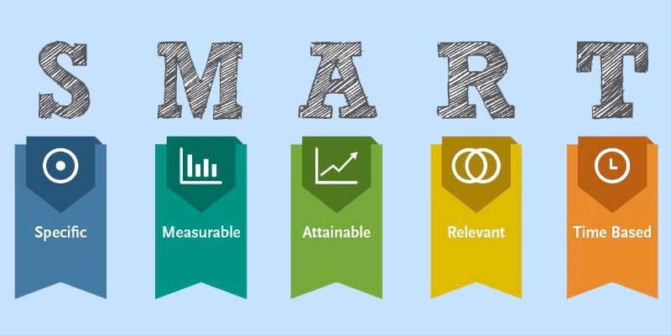
Step 3: Vision/Goals
What is the overall vision?
Notes:
22

Slide 20
This project aims to ensure that all the leaflets are clinically correct and safe for patient use
The project will review all the leaflets held by the practise, update them, check to see if they’re already on the website and if not, upload them. The project will also make sure that all the leaflets are regularly reviewed
This project aims to review the process for updating leaflets held by the practise, the project will update the all information and circulate by September 2023

Slide 21
The project will create a new, defined and articulated process for updating leaflets within the practise. The new process will be launched within Practise A in October 2023 and reviewed December 2023
Specific - create a new, defined and articulated process
Measurable – Has a process been created?
Achievable – This can be done effectively
Realistic – Yes, it’s creating a new process
Timebound – October 2023

Slide 22
Step 4: Root Cause Analysis
Techniques to dig deeper:
Looking closely at the issue

Slide 23
Cause and effect
Fishbone Analysis
Cause and effect to look at underlying factors
Gain
Gain insight from the team
Use
Use to determine why a particular problem is occurring
Notes:
Has anyone used a fishbone? Developed in Japanese industry, it’s a literal fish with bones and spines that help to categorise some of the challenges and help groups to think where the biggest issue sits
28

Slide 24
People
Place
Person who did leaflets has left
On website and hard copies
No time to do this
Need clinical input
Distribute to other sites
Patients getting info that’s wrong
Leaflets are out of date
Who signs them off?
Printers take ages
Admin team do this?
I don’t know how to update leaflets
We rely on other agencies for the information
Process
Providers

Slide 25
5 Whys
The leaflets are out of date
Nobody updates them
Why are they out date?
Person who did it has left
Why doesn’t anyone update them
Why hasn’t that task been allocated to new person?
Nobody knows what the process is
Why doesn’t anyone know what the process is?
It was never written down
Why wasn’t it written down
It was a task undertaken by one person with the implicit knowledge
Notes:
Simple approach to start the conversation and to drill into the root cause.
30

Slide 26
Use process mapping to get a better understanding of how a whole pathway works. If changes are made without understanding the current processes issues may occur at another point in the journey.
TASK
DECISION
DECISION
TASK
TASK
TASK
Notes:
What is the learning? Would another technique have worked better?
Did you get to a root cause?
33

Slide 27
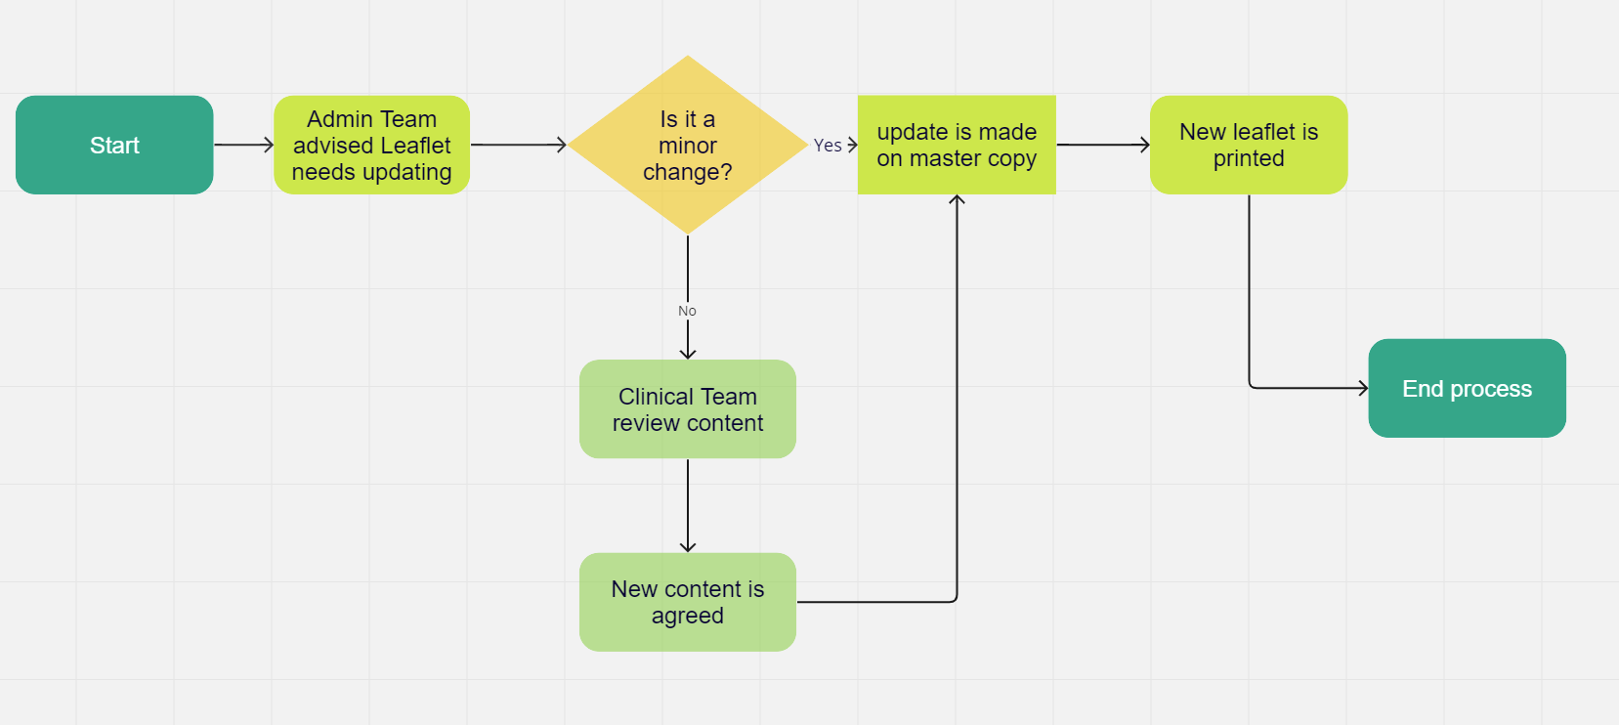
Leaflets Process

Slide 28
Step 5: Design the Improvement
Plan
Do
Well known improvement tool
This fits nicely into the A3 Thinking model
Act
Study

Slide 29
What will you change or test?
Have you got a baseline data set?
What do you predict will happen?
What happened when you carried out your test?
What did the data show?
Did the change result in an improvement?
Plan
Do
Will you ADOPT the change, ADAPT it or ABANDON it?
Will you do another PDSA cycle
Act
Study
What have you noticed?
Were there any unexpected outcomes?

Slide 30
Remember!
This is Rapid Cycle Improvement
Fail stands for First Attempt in Learning!
Doing is only 25% of the circle
It’s an iterative process

Slide 31
Step 6: Tests of Change
Sustained improvement
P
D
DATA
A
S
P
D
A
S
P
D
A
S
P
D
Change Ideas
A
S

Slide 32
Step 7. Reflect and Learn
Evaluation
Analysis
Feedback
Improve
Check

Slide 33
Step 7. Reflect and Learn
Evaluation
Analysis
Feedback
Improve
Check

Slide 34
Further Information and downloadable resources can be found at:
https://bswtogether.org.uk/academy/home/improvement/
Or by emailing sarah.white120@nhs.net
Notes:
Quick round of introductions –
4

