Slide 1
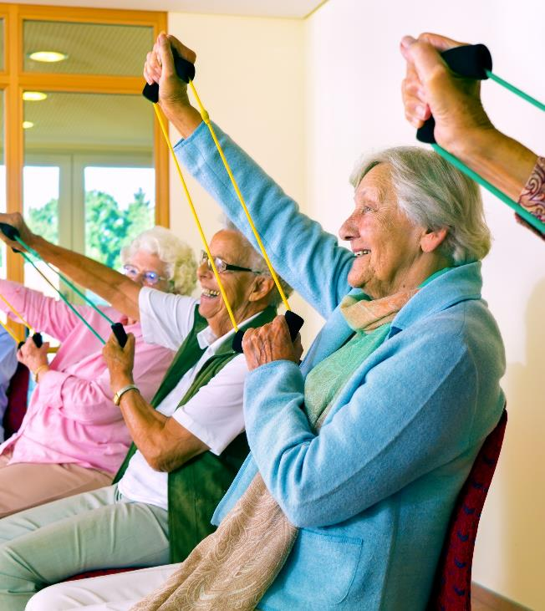
Bath and North East Somerset, Swindon and Wiltshire Together
An introduction to our Integrated Care System

Slide 2
What is an Integrated Care System (ICS)?
The health and care needs of our population are changing, with more people living longer, often with multiple long term conditions
To tackle this and other health and care problems the NHS, local government and the third sector have formed partnerships to better meet our populations’ needs now and in the future
Right click above and open hyperlink to watch a short animation

Slide 3
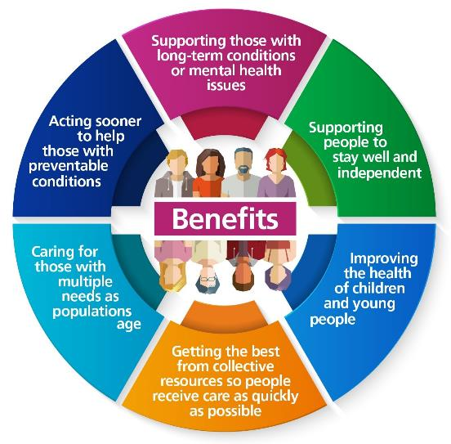
Integrated Care Systems...
Have been shown to deliver the best outcomes for patients and populations across the UK and internationally
Involve all care providers and commissioners working together to deliver an agreed set of outcomes for our population
Help to simplify an overly complex system to improve services and make the most effective use of budget and resources

Slide 4
Bath and North East Somerset, Swindon and Wiltshire (BSW) Together
Care organisations in Bath and North East Somerset, Swindon and Wiltshire have been working together since 2016 as a Sustainability and Transformation Partnership (STP)
Following designation from NHS England and Improvement in December 2020, the BSW Partnership is now an Integrated Care System working alongside an Integrated Care Board that became a statutory body on 1st July 2022

Slide 5
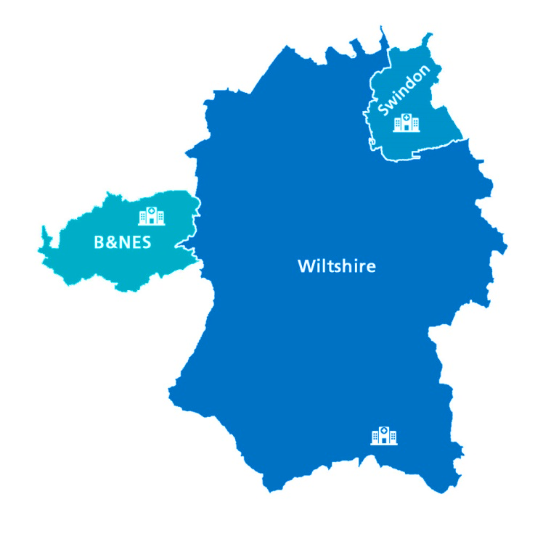
How the BSW ICS is made up
Integrated Care Alliances (ICA)
Place-based partnerships of NHS, councils, community and voluntary organisations, local people, carers
Lead the design and delivery of integrated services at place
Integrated Care System (ICS)
Organisations that come together to plan and deliver joined up health and care services, and to improve the lives of people who live and work in their area
Integrated Care Board
BSW ICB
(organisation)
Integrated Care Partnership
BSW ICP
(committee)
B&NES
Council
Swindon
Council
Wiltshire
Council
Statutory committee, formed between the ICB and local authorities
A broad alliance of organisations concerned health and wellbeing of the population
Author of the Integrated Care Strategy advocate for innovation, new approaches and improvement
Statutory NHS organisation
Develops a plan for meeting the health needs of the population,
Managing NHS budget
arranges for the provision of health services in BSW
Local Authorities
Responsible for social care and public health functions and other services for local people and businesses

Slide 6
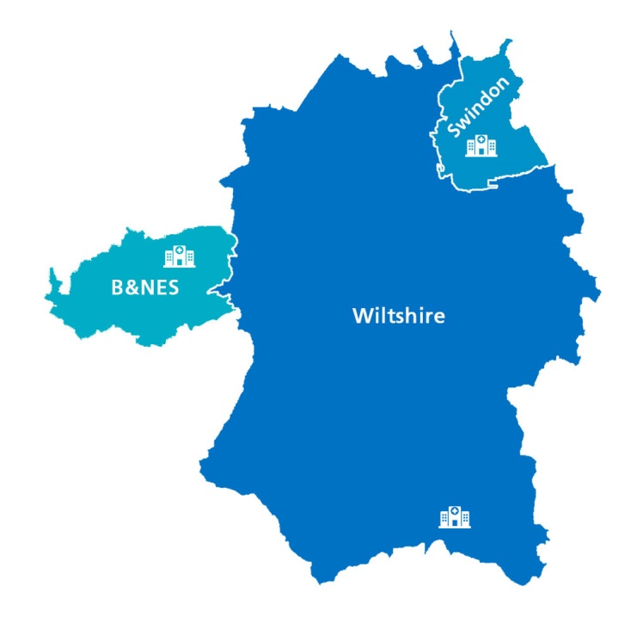
Who we are
We serve a combined population of 940,000
We directly employ 37,600 colleagues and benefit from the contribution of many more carers and volunteers
We are made up of 88 GP practices, 26 Primary Care Networks, two community providers, three acute hospital trusts, two mental health trusts, an ambulance trust, an Integrated Care Board (ICB), three Local Authorities, 2,800 Voluntary, Community and Social Enterprises

Slide 7
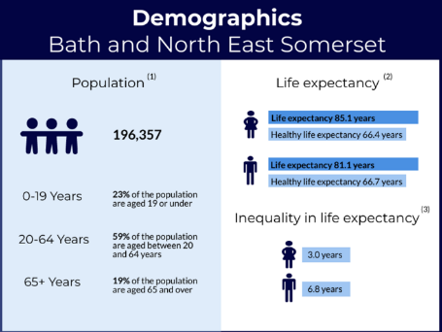
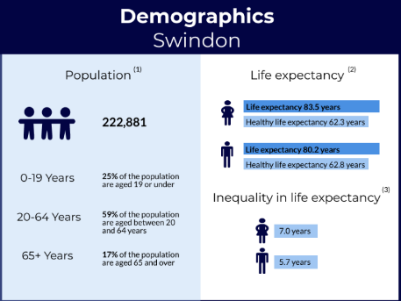
Key population demographics and issues in BSW

Slide 8
Areas of concern in BSW
180,000 people have some form of mental health condition
Nearly 6% of the population has diabetes
100,000 adults are smokers
156,000 people have three or more long-term conditions
85,000
people aged 65+ receive ten or more regular prescriptions for medicines
(Taken from BSW Partnership ‘NHS Long Term Plan - internal intelligence briefing’ 2021)

Slide 9
Our vision: Working together to empower people to lead their best life
Plus, a wide range of voluntary and community sector organisations that help provide invaluable support to our populations and our health and care services

Slide 10
Our vision: Working together to empower people to lead their best life
Provide better joined-up care
Enhance productivity and value for money
Help the NHS support broader social and economic development
Reduce health inequalities
Our purpose
The changes to the way we organise services are important steps in our journey to become a thriving integrated care system by 2023 and contribute to our core purpose

Slide 11
BSW Academy
Enabling collaboration across health and care services for the benefit of the people working with us and those in our local communities, providing inclusive, rewarding career progression and opportunities

Slide 12
Involving people and communities
The vision for involvement in BSW is for all partner organisations to listen to and act on the aspirations and experiences of people and communities including their hopes for their future health and wellbeing.
Insights driven
Tackling health inequalities
Empowering people and communities
A culture that champions involvement

Slide 13
Working together across BSW
Health and care providers across BSW have a long history of collaborative working
The following slides include current examples of how we are working together now

Slide 14
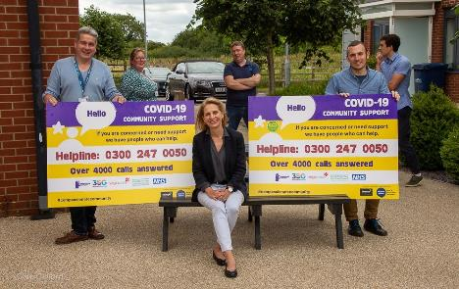
Support from the voluntary sector
Voluntary sector organisations, working with BSW health and care providers, offering vital support to vulnerable members local communities during lockdowns
Community groups help people with food deliveries, medicine, urgent housing, mental health and wellbeing and money matters
Highlights the important role played by third sector in BSW ICS

Slide 15
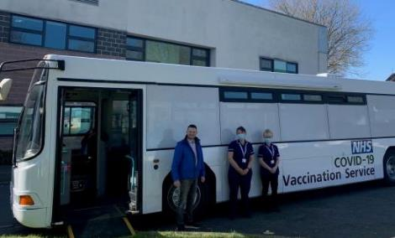
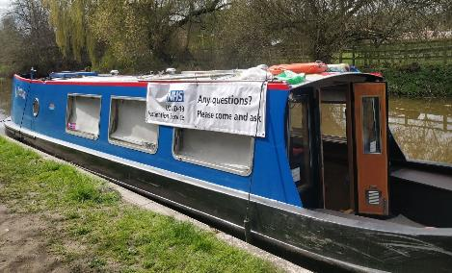
Addressing inequalities through access to Covid vaccine
BSW ICB, local authorities, GP surgeries, primary care networks and local voluntary sector groups working together to deliver vaccines on a specially adapted canal barge and bus
Initiative ensures hard to reach communities across the local area do not miss out on the opportunity to receive Covid vaccinations

Slide 16
Support for Long Covid
New clinical pathway co-created across BSW to respond to patients experiencing long term effects of Covid-19
The service consists of an assessment process with a 30 minute virtual assessment by a senior physiotherapist, occupational therapist or nurse
Support from virtual Multi Disciplinary Team including specialist physio, GP, chronic fatigue consultants, occupational health physician and secondary care consultants
Funding for a Long Covid clinic would not have been possible without the collaboration of system partners

Slide 17
Integrated Care Records (ICRs)
Part of a programme of work to improve the care our population receives through digital transformation
An ICR enables different health and care organisations to access relevant information about patients without the need to access multiple IT systems
It was used by health & care professionals over 23,000 times in May 2022 and covers 934,000 residents across B&NES, Swindon and Wiltshire
It shares information between our community care providers, acute hospitals, GP practices, and mental health trusts saving time and avoiding unnecessary delays while improving patient care

Slide 18
Wellbeing houses
Local authorities, mental health trusts, housing providers and VCSE groups working together to help people at a point of crisis
Offers an alternative to going for hospital for those who don't feel safe at home overnight, or where things at home are contributing to a crisis
Helps to keep people out of hospital in a welcoming, non-clinical, homely environment and offers patients strategies to stay well and avoid re-admission
Provides a focus on next steps, using skilled staff to help users move on and to make contact with community outreach, financial, housing, employment and training pathway organisations

Slide 19
What does this mean for me?
Becoming an ICS will mean changes ahead for all of us as our organisations work more closely together
If you have any questions, please email bswicb.partnership@nhs.net

Slide 20
More information
Visit the BSW Partnership website at bswtogether.org.uk
Email bswicb.partnership@nhs.net
Sign up for our regular Triangle newsletter (for members of the public)
Sign up for our regular #BSWTogether (for colleagues)
Follow us on Twitter @BSW_Together

