Slide 1
BSW MMR signs and symptoms
February 2024

Slide 2
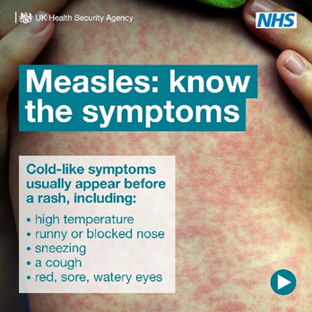
Measles spreads easily. Anyone who is not vaccinated can catch it. Measles can cause serious complications and can be fatal, so make sure you’re up to date with #MMR vaccinations and ask your GP practice about catch up jabs if needed. More info here 👉 https://bswtogether.org.uk/yourhealth/mmr/
GIF. Measles: know the symptoms graphics

Slide 3
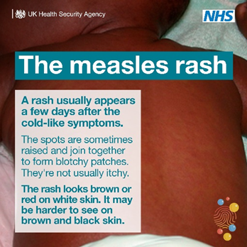
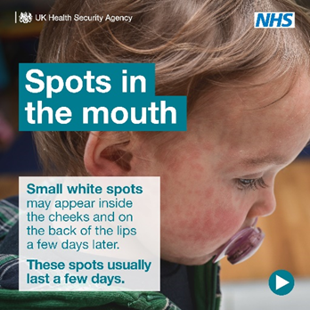
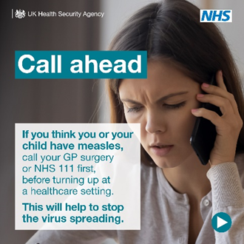
Measles: know the symptoms
Cold-like symptoms usually appear before a rash, including: High temperature, Runny or blocked nose, Sneezing, A cough, Red, sore, watery eyes
The measles rash. A rash usually appears a few days after the cold-like symptoms. The spots are sometimes raised and join together to form blotchy patches. They’re not usually itchy. The rash looks brown or red on white skin. It may be harder to see on brown and black skin.
Spots in the mouth. Small white spots may appear inside the cheeks and on the back of the lips a few days later. These spots usually last a few days.
Call ahead. If you think you or your child have measles, call your GP surgery or NHS 111 first, before turning up at a healthcare setting. This will help to stop the virus spreading.

Slide 4
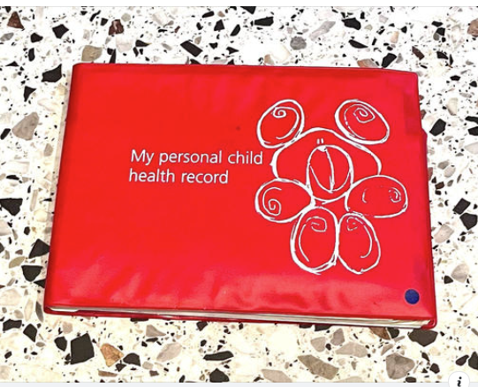
Short copy: Measles spreads easily. Anyone who is not vaccinated can catch it. Measles can cause serious complications and can be fatal, so make sure you’re up to date with #MMR vaccinations and ask your GP practice about catch up jabs if needed. More info here 👉 https://bswtogether.org.uk/yourhealth/mmr/
Long copy: MEASLES | With an increase in cases of measles in some parts of the country, it’s important to ensure you and your children are protected with both doses of the MMR vaccine.
If you or your child missed one or both doses, it isn’t too late to catch up, even in adulthood.
How to check your family’s vaccine status
Check your child’s Personal Child Health Record (PCHR), known as the red book Via the NHS app (vaccination status is only available on the app for some people)
If you cannot access either of the above, your GP surgery should be able to check for you. If you do have to contact your GP surgery, please be patient and kind at what is a very busy time of year for practice teams.
Find out more about the vaccine here:

Slide 5
Measles can cause serious complications and can be fatal. But 2 doses of the #MMR vaccine can offer protection for life. Make sure you & your loved ones are up to date with their jabs, and if not, contact your GP practice for a catch-up appointment. 👉 https://bswtogether.org.uk/yourhealth/mmr/
GIF. Measles: know the symptoms graphics

Slide 6
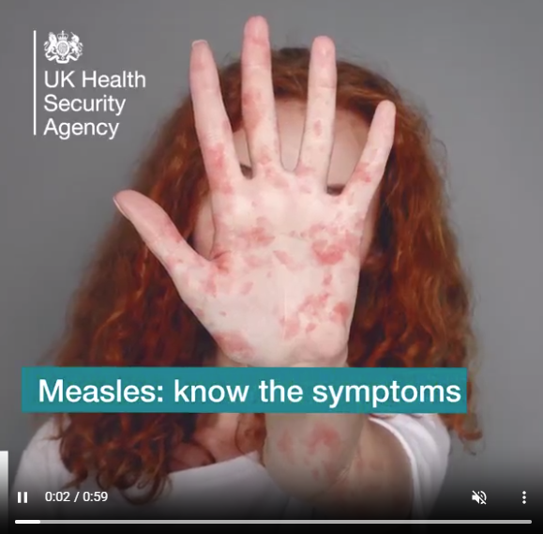
Here’s what you need to know about #measles, from the signs and symptoms to look for to what to do if you think you or your child has measles. More info 👉 https://bswtogether.org.uk/yourhealth/mmr/
Video

Slide 7
#Measles can be a serious infection that can lead to complications, especially in young children & those with weakened immune systems. We’re reminding parents on what signs and symptoms to look out for and what to do if they think their child has measles. Measles spreads easily but it is preventable. Make sure you & your loved ones are up to date with your #MMR jabs or catch up on any missed jabs. More info here 👉 https://bswtogether.org.uk/yourhealth/mmr/
Carousel graphics

Slide 8
Landing pages
MMR vaccination
https://bswtogether.org.uk/yourhealth/mmr/
Measles –signs and symptoms
https://bswtogether.org.uk/yourhealth/measles-2/

